Slide 1

Green Pace
Security Policy Presentation
Developer: Tek Bista
Why a security policy at Green Pace?
Because we make our customer feel secure.

Slide 2

OVERVIEW: DEFENSE IN DEPTH
Defense in depth is an arrangement of defensive line in security system where several independent layer of security control are used. Here every layer works independently so that if one fails another will be operative. We can practice defense in depth by:
Use of firewall to prevent access via non-web ports.
Encrypt all sensitive data.
Use triple A policy.
Implement unit testing best practices.
Validate the user input data.

Slide 3
THREATS MATRIX
Likely INT-001-CPP DTV-002-CPP STR-003-CPP SQL-004-CPP MEM-005-CPP ASR-006-CPP ERR-007-CPP ARR-010-CPP | Priority SQL-004-CPP DTV-002-CPP STR-003-CPP MEM-005-CPP ASR-006-CPP
Low priority ERR-007-CPP FIO-008-CPP INT-009-CPP ARR-010-CPP | Unlikely FIO-008-CPP

Slide 4
10 PRINCIPLES
Validate User Input
Heed Compiler Warning
Architect and Design for Security Policies
Keep it Simple
Default Deny
Adhere to the principle of least privilege
Sanitize Data Sent to Other Systems.
Practice Defense in Depth.
Use effective quality assurance techniques.
Adopt a secure coding standard
;

Slide 5
CODING STANDARDS
SQL Injection
Memory protection
File input output
Exception
Array
Assertion
Data Value
String Correctness
Data type
Integer Division

Slide 6
ENCRYPTION POLICIES
Encryption in rest: Encryption of data when it is in rest position. For instance, when the data is stored on disk or database.
Encryption at flight: Encryption of data while it is being transmitted. It is important to encrypt data at flight because attacker could potentially sniff the network traffic and gain access to the data as it traverse the network.
Encryption in use: Encryption in use is capability that lets us run our computation on encrypted data or encrypted application. It is used to protect data in memory.

Slide 7
TRIPLE-A POLICIES
Authentication: Authentication is the process of identifying a use, typically by having login credential such as username and password before access is granted.
Authorization: Authorization is the process of identifying the role of the user in the system.
Accounting: Accounting is the process of measuring the resources a user consumes during access. It tracks the amount of data user sent and/ or received during a session.

Slide 8
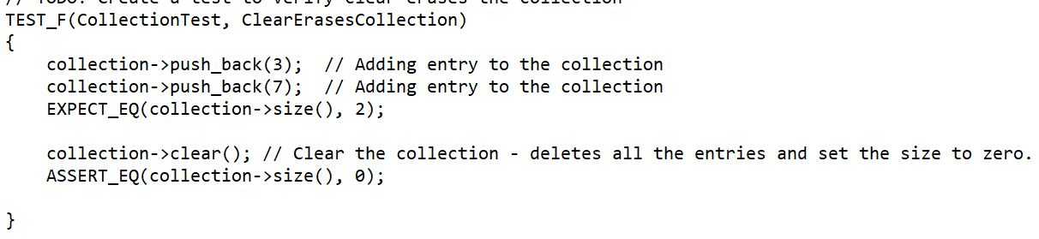
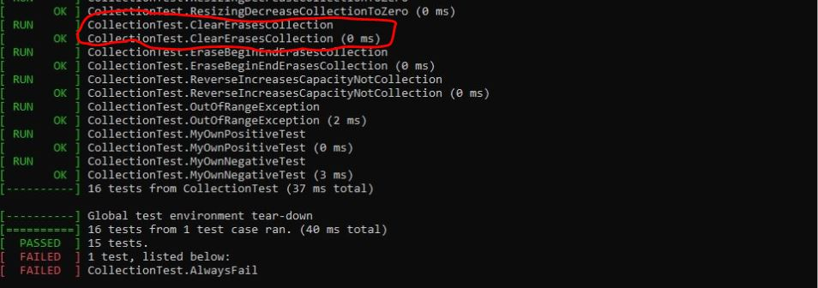
Unit Testing
Test to verify clear erases the collection.
Test case
Result

Slide 9
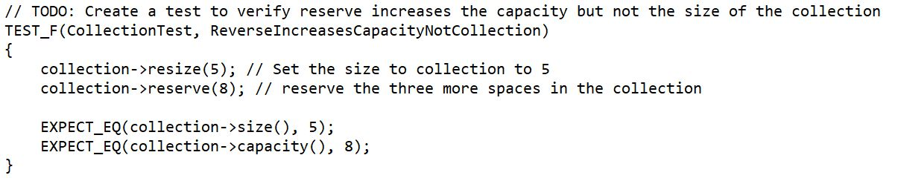
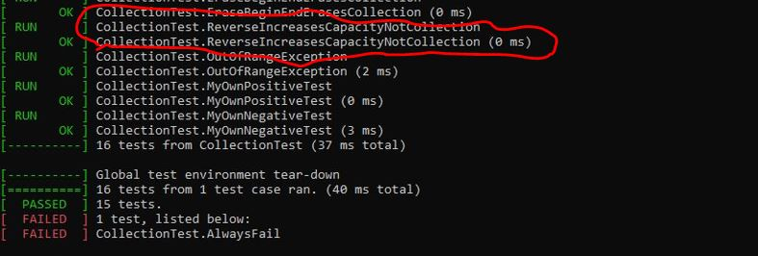
Test to verify reserve increases the capacity but not the size of the collection.
Test case
Result

Slide 10
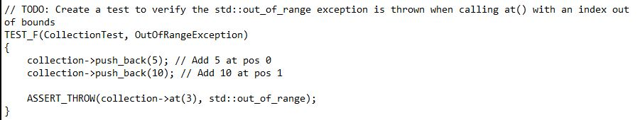
Test to verify that std::out_of_range exception is thrown when calling at() with an index out of bound.
Test case
Result

Slide 11
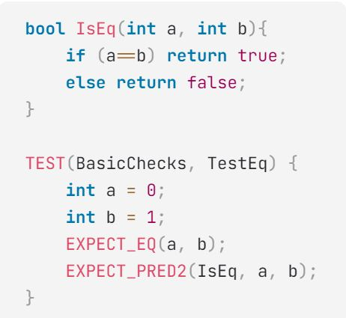
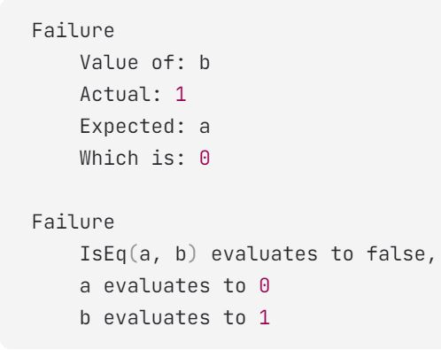
Test to verify that the value of two variables are not equal.
Test case
Result

Slide 12

AUTOMATION SUMMARY

Slide 13
TOOLS
A traditional DevOps pipeline has several distinct phases such as plan, code, build, Test, Release, Deploy, Operate, and Monitor. With DevSecOps, there are distinct security steps that happen during each of those phases such as threat modeling, scan, analyze, remediate, and monitor.
SAST Tool (Static Application Security Testing)
SAST tools is one among the most used essential security testing tools that DevSecOps teams can use in their workflow. It is easy to automate, scalable, and automatically provide the highest levels of code coverage. It performs automated scans of the application’s code to identify security risk for OSS software, libraries, containers, and other related artifacts that may have open vulnerabilities.
-Stuart Foster, DevSecOps Pipeline Overview (Jan 22, 2021)

Slide 14
RISKS AND BENEFITS
Risk of leavening security to the end
Difficult to detect errors, bugs, and vulnerabilities.
High probability of causing damage to the system.
Solution
Check for errors and bugs in every steps of your coding.
Use secure coding best practices.
Keep updating about latest vulnerability issues and bugs.
Benefits
Secure the system and software.
Reduce failure rate.

Slide 15
RECOMMENDATIONS
Be prepare for upcoming breaches
Be prepare for unknown threats
Lack of monitoring
Third party / vendor risks
Incident handling

Slide 16
CONCLUSIONS
Security needs to be prioritize before writing code.
Encrypt all the sensitive data like password and credit/debit card information.
Deny access to any user that cannot demonstrate authentication and authorization.
Use error handling and logging technique to minimize the impact of vulnerabilities.
Validate all inputs and sources from user.

Slide 17
REFERENCES
Stuart Foster, DevSecOps Pipeline Overview retrieved on April 17, 2021 from https://www.perforce.com/blog/kw/devsecops-pipeline-overview#:~:text=What%20Is%20a%20DevSecOps%20Pipeline,secure%20software%20faster%20and%20easier.
Sarah Harvey, Secure Coding Best Practices retrieved on April 17, 2021 from https://kirkpatrickprice.com/blog/secure-coding-best-practices/

